Slide 1


Oracle database
Lecture 41

Slide 2

Today’s Agenda
Cursor In PL-SQL
Types Of Cursors
Implicit Cursor
Explicit Cursor

Slide 3
Introduction To Cursor
When an SQL statement is processed, Oracle creates a memory area known as context area.
This context area contains information regarding rows retrieved from table, their count etc.
A Cursor is basically a pointer to this Context Area i.e. a ‘Cursor’ is the PL/SQL construct that allows the user to name the work area and access the stored information in it.

Slide 4
Types Of Cursor
There are two types of cursors:
Implicit
Explicit

Slide 5
Implicit Cursor
They are generated automatically by Oracle server when an SQL statement occurs in the PL/SQL executable part; like SELECT INTO , INSERT , UPDATE or DELETE .
For INSERT operations, the cursor holds the data that needs to be inserted.
For UPDATE and DELETE operations, the cursor identifies the rows that would be affected.

Slide 6
Implicit Cursor Attributes
Attribute | Description
SQL%FOUND | Its return value is TRUE if DML statements like INSERT, DELETE and UPDATE affect at least one row or more rows or a SELECT INTO statement returned one or more rows. Otherwise it returns FALSE.
SQL%NOTFOUND | Its return value is TRUE if DML statements like INSERT, DELETE and UPDATE affect no row, or a SELECT INTO statement return no rows. Otherwise it returns FALSE. It is a just opposite of %FOUND.
SQL%ISOPEN | It always returns FALSE for implicit cursors, because the SQL cursor is automatically closed after executing its associated SQL statements.
SQL%ROWCOUNT | It returns the number of rows affected by DML statements like INSERT, DELETE, and UPDATE or returned by a SELECT INTO statement.

Slide 7
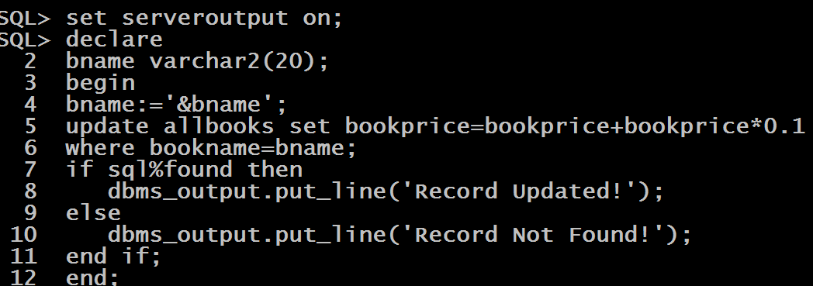
Example
WA PL-SQL script to accept a book name from the user and increase the bookprice by 10%. Also check whether the update was done or not

Slide 8
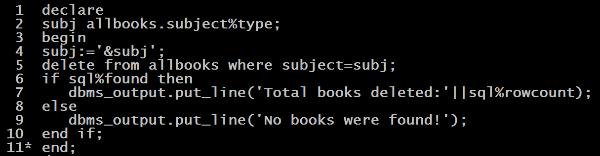
Example
WA PL-SQL script to accept a subject from the user and remove all the books belonging to that subject. Also display how many books were deleted.

Slide 9
Explicit Cursor
Explicit cursors are programmer-defined cursors for gaining more control over the context area.
An explicit cursor should be defined in the declaration section of the PL/SQL Block.
It is created on a SELECT Statement which returns more than one row.

Slide 10
Explicit Cursor
The syntax for creating an explicit cursor is −
CURSOR cursor_name IS select_statement;
Working with an explicit cursor includes the following steps −
Declaring the cursor for initializing the memory
Opening the cursor for allocating the memory
Fetching the cursor for retrieving the data
Closing the cursor to release the allocated memory

Slide 11
Explicit Cursor
Declaring the Cursor
Declaring the cursor defines the cursor with a name and the associated SELECT statement.
For example −
CURSOR c_customers IS SELECT id, name, address FROM customers;

Slide 12
Explicit Cursor
Opening the Cursor
Opening the cursor allocates the memory for the cursor and makes it ready for fetching the rows returned by the SQL statement into it.
For example, we will open the previously defined cursor as follows −
OPEN c_customers;

Slide 13
Explicit Cursor
Fetching the Cursor
Fetching the cursor involves accessing one row at a time.
For example, we will fetch rows from the c_customers cursor as follows −
FETCH c_customers INTO c_id, c_name, c_addr;

Slide 14
Explicit Cursor
Closing the Cursor
Closing the cursor means releasing the allocated memory.
For example, we will close the c_customers cursor as follows −
CLOSE c_customers;

Slide 15
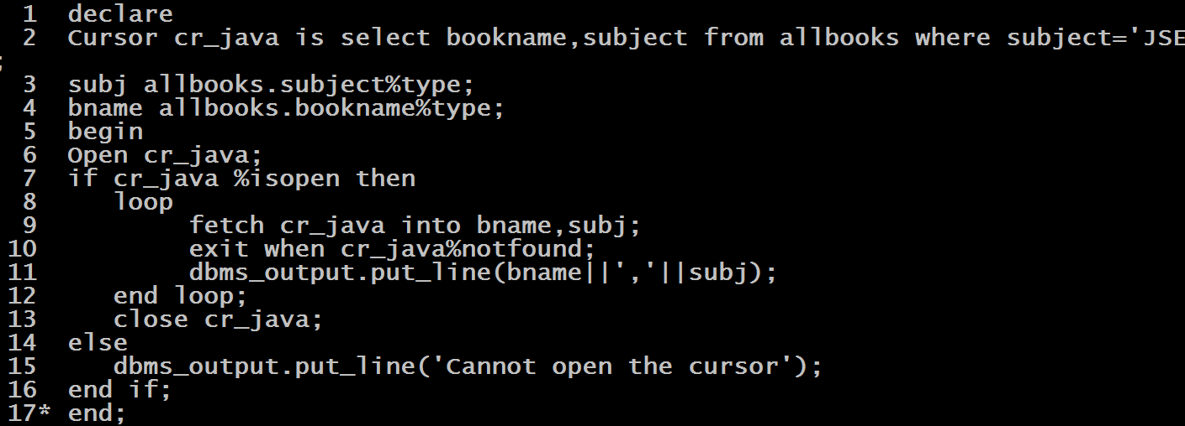
Example
WA PL_SQL script to display bookname and subject of all the books belonging to JSE.

